Slide 1

Instrument your BTP based Custom application with the help of Open Telemetry for SAP Cloud ALM
Anbusivam S, SAP
Muthu Hariharan M, SAP

Slide 2
Agenda
SAP Cloud ALM for Operations
Overview
Next Generation Data Collection Infrastructure
Overview
Hands-on
Set up Monitoring with SAP Cloud ALM

Slide 3
SAP Cloud ALM for Operations

Slide 4

SAP Cloud ALM for Operations – Functional Overview
Service Level Management
Business Service Management
Event Calendar
Business Process Monitoring
Alert Management
Metrics
Emails
Integration & Exception Monitoring
Config Items
Intelligent Event Processing
Chats
Notification Management
Synthetic & Real User Monitoring
Tickets
Log Entries
Tasks
Job & Automation Monitoring
External API Management
Analytics Data
Events
Configuration & Security Analysis
Operations Automation
Operations Flows
Alerts
Health Monitoring
Analytics & Intelligence
Inbound Integration
Problem Detection
Problem Routing
Problem Resolution
Outbound Integration

Slide 5
Next Generation Data Collection Infrastructure

Slide 6
Next Generation - Data Collection Infrastructure - Goals
Provide sufficient instrumentation support ➔ Addressed by Data Collection Instrumentation Library
Minimize instrumentation efforts for customers, partners and SAP’s development teams
Use standard Open Telemetry, whenever possible ➔ Extend standard Open Telemetry, whenever necessary
Use auto-instrumentation, whenever possible ➔ Extend it with source code instrumentation, whenever necessary
Support all use cases as standardized as possible e.g. unified connectivity handling
Enable end-to-end correlation by hybrid approach of SAP Passport and Open Telemetry based correlation
Provide unified data collection runtime ➔ Addressed by Data Collector Runtime
Unify runtime for push based and pull based data collection
Provide unified approach for customer facing as well as SAP internal use cases
Replace customer managed connectivity (tenant-to-tenant) with SAP managed connectivity (application-to-application) for SAP based SaaS scenarios
Increase quality of data delivery by efficient queuing
Provide unified approach for data routing and data exchange ➔ Addressed by SAP Cloud ALM
Enable dynamic routing of data to corresponding SAP Cloud ALM tenant across data centers
Embrace openness regarding data exchange:
Import data from 3rd party services/systems based on Open Telemetry based inbound API’s
Export data to 3rd party services/systems based on Open Telemetry based outbound API’s
Forward data to SAP Focused Run
Increase quality of data delivery by efficient queuing

Slide 7
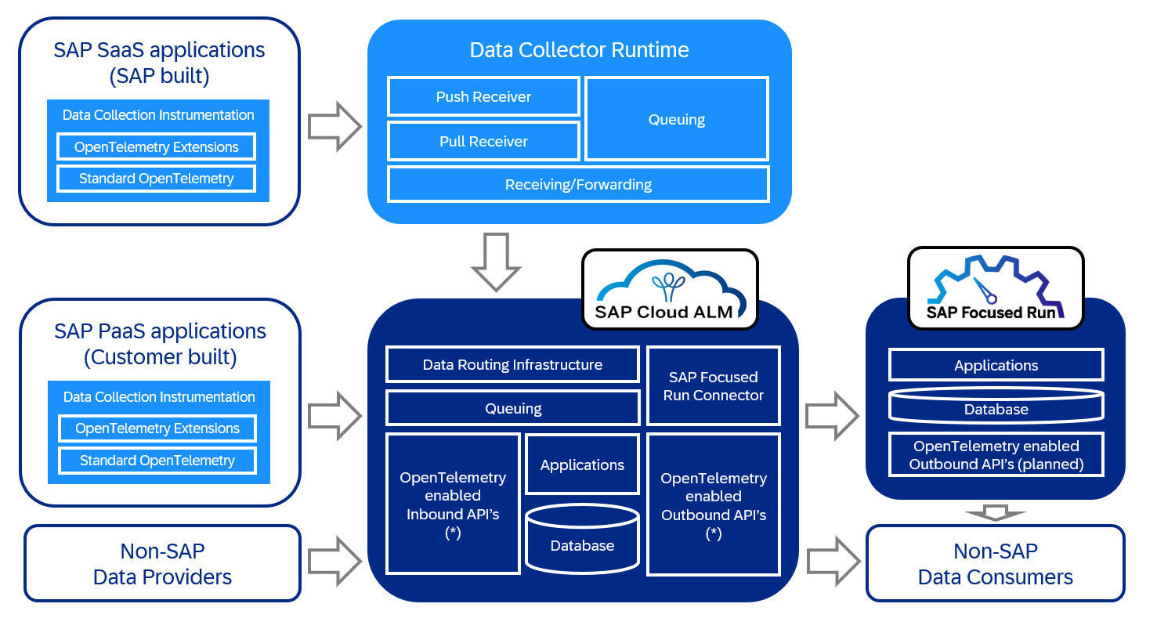
Next Generation Data Collection Infrastructure
This is the current state of planning and may be changed by SAP at any time.

Slide 8
Supported Monitoring Functionality for BTP SaaS (SAP-managed)
Integration Monitoring
Exception Monitoring
Job & Automation Monitoring
Real User Monitoring
Health Monitoring
Configuration & Security Analysis

Slide 9
Supported Monitoring Functionality for BTP PaaS (Customer-managed)
Exception Monitoring
Real User Monitoring
Health Monitoring
Job & Automation Monitoring (Manual)

Slide 10
Hands-on

Slide 11
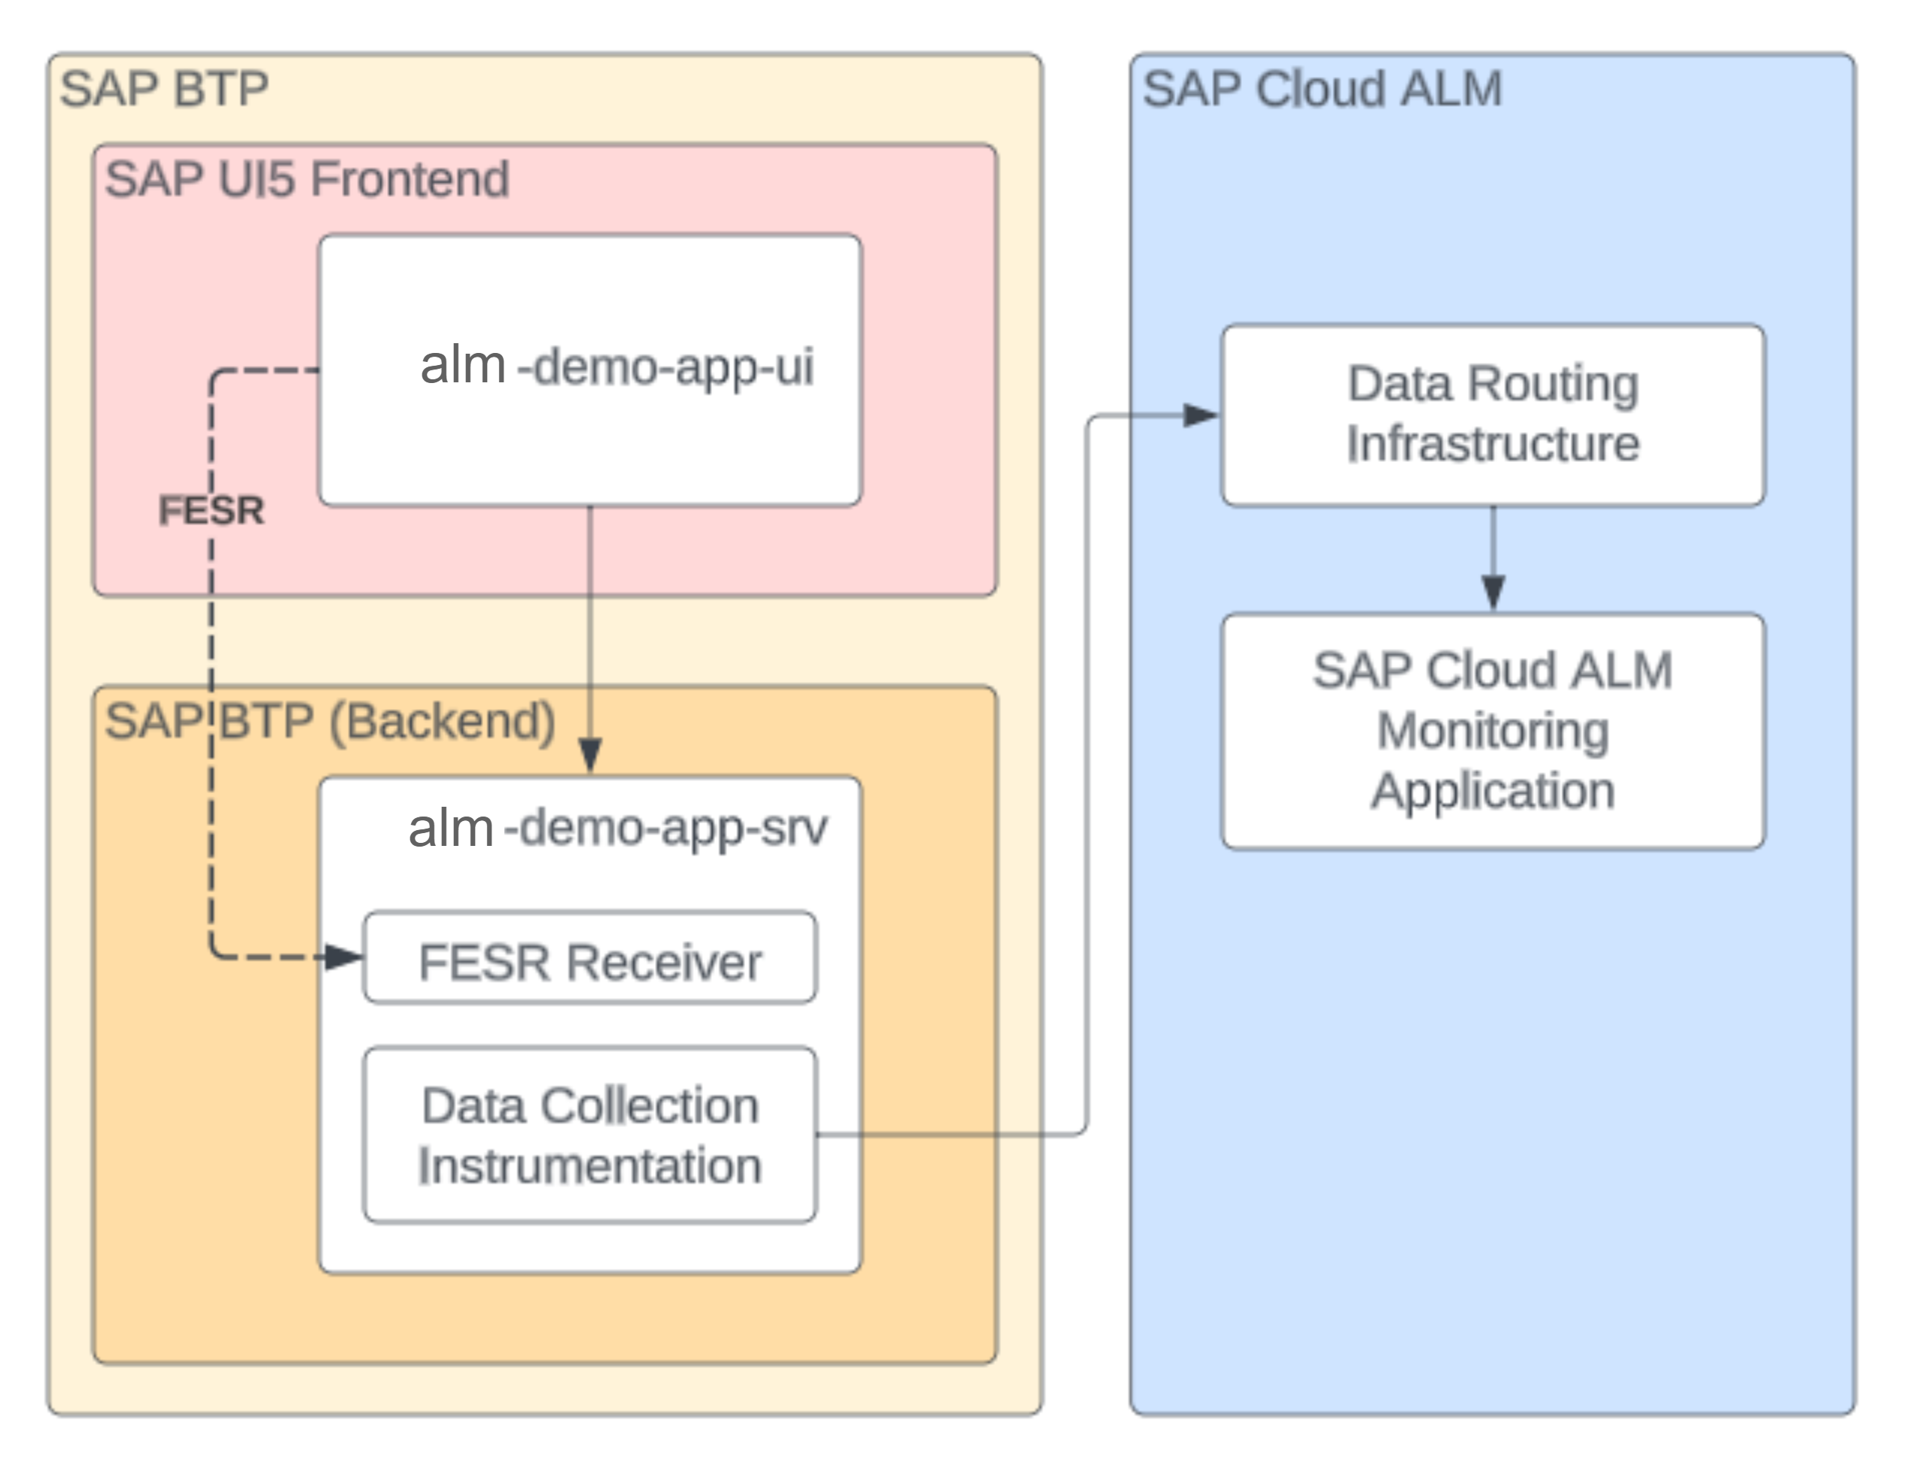
Demo Application Setup

Slide 12
Hands-on Flow
Local Dev Environment
SAP BTP Cockpit
SAP Cloud ALM
Part 1
1 Create destination from custom app to SAP Cloud ALM
4 Activate Monitoring in SAP Cloud ALM
2 Instrument custom app to send metrics to SAP Cloud ALM
3 Deploy instrumented application

Slide 13
Q&A

Slide 14
Thank you

Slide 15


Next Generation Data Collection Infrastructure
This is the current state of planning and may be changed by SAP at any time.
Producer
Routing
Consumer
SaaS scenario (multiple tenant - provider account)
Data Collector Runtime
Runtime data
Push Receiver
Pull Receiver
Data Collection Instrumentation
Pull based Data Providers
Dynatrace
…
OTEL Extensions
Configuration data
Queuing
Used for cross customer cloud operations
SAP Internal
Open Telemetry
Runtime data
Customer Distributor
SAP Focused Run Proxy (2)
SAP Cloud LOB owned data providers as Dynatrace, Prometheus ..
Runtime data
Configuration data
PaaS scenario (single tenant – cons. account)
3rd Party tools e.g. Grafana, Splunk, AppDynamics, Prometheus, ...
Runtime data
Runtime data
Customers/Partners
Data Collection Instrumentation
Pull based Data Providers
Data Routing Infrastructure
Open ALM Inbound API (1)
OTEL Extensions
Configuration data
Queuing
Open Telemetry
CALM Customer Tenant
3rd party data providers for non-SAP products e.g. data for salesforce.com
SAP Focused Run Proxy
CALM Database
Runtime data
Open ALM Outbound API (2)
Runtime data
Open ALM Outbound API (1)
Configuration data
(1) Partially available
(2) Planned

Slide 16
SAP Cloud ALM for Operations – Value Proposition
Ensures business continuity - Keeps the lights on - Increases operations efficiency - Predicts critical situations - Provides status events for business services - Reduces TCO
SAP Cloud ALM empowers customers to understand health of SAP business solutions:
Provides full stack monitoring and alerting covering business processes, integration, users, jobs & tasks, applications, and health of services and systems
Allows to conduct root cause analysis on different levels via embedded dashboards
Acts as collaboration platform between LOB and IT
SAP Cloud ALM enables operations automation by integrating existing automation solutions
SAP Cloud ALM introduces intelligent event processing as central routing infrastructure to enable event correlation and intelligent alerting
SAP Cloud ALM provides transparency regarding the health of business services including event calendar and service level management

